Slide 1








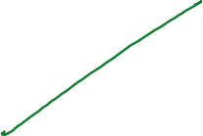



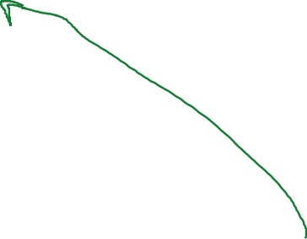








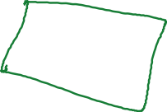



















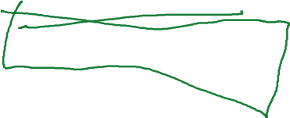
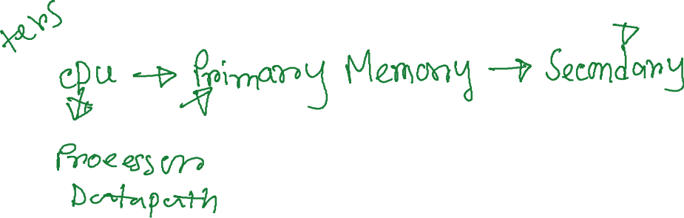
COD Ch. 7
Large and Fast: Exploiting Memory Hierarchy

Slide 2
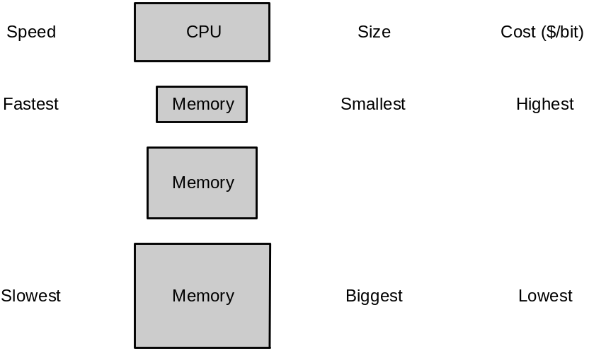
Memories: Review
DRAM (Dynamic Random Access Memory):
  value is stored as a charge on capacitor that must be periodically refreshed, which is why it is called dynamic
  very small – 1 transistor per bit – but factor of 5 to 10 slower than SRAM
  used for main memory
SRAM (Static Random Access Memory):
  value is stored on a pair of inverting gates that will exist indefinitely as long as there is power, which is why it is called static
  very fast but takes up more space than DRAM – 4 to 6 transistors per bit
  used for cache

Slide 3













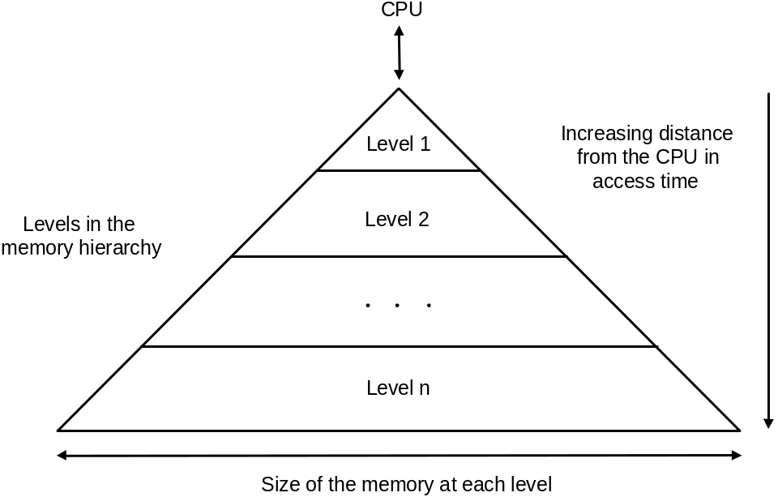
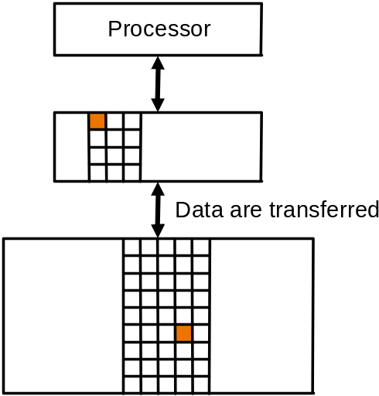




Memory Hierarchy
Users want large and fast memories…
  expensive and they don’t like to pay…
Make it seem like they have what they want…
  memory hierarchy
  hierarchy is inclusive, every level is subset of lower level
  performance depends on hit rates
Block of data
(unit of data copy)

Slide 4





Locality
Locality is a principle that makes having a memory hierarchy a good idea
If an item is referenced then because of
  temporal locality: it will tend to be again referenced soon
  spatial locality: nearby items will tend to be referenced soon
  why does code have locality – consider instruction and data?

Slide 5





Hit and Miss
Focus on any two adjacent levels – called, upper (closer to CPU) and lower (farther from CPU) – in the memory hierarchy, because each block copy is always between two adjacent levels
Terminology:
  block: minimum unit of data to move between levels
  hit: data requested is in upper level
  miss: data requested is not in upper level
  hit rate: fraction of memory accesses that are hits (i.e., found at upper level)
  miss rate: fraction of memory accesses that are not hits
    miss rate = 1 – hit rate
  hit time: time to determine if the access is indeed a hit + time to access and deliver the data from the upper level to the CPU
  miss penalty: time to determine if the access is a miss + time to replace block at upper level with corresponding block at lower level + time to deliver the block to the CPU

Slide 6
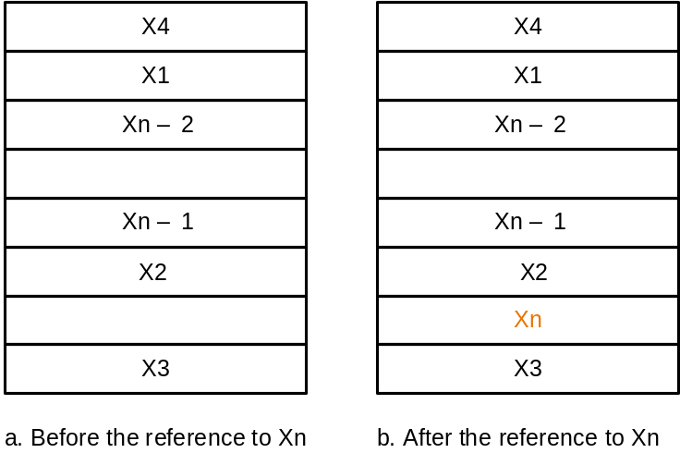
Caches
By simple example
  assume block size = one word of data
Issues:
  how do we know if a data item is in the cache?
  if it is, how do we find it?
  if not, what do we do?
Solution depends on cache addressing scheme…
Reference to X_{n}
causes miss so
it is fetched from
memory

Slide 7


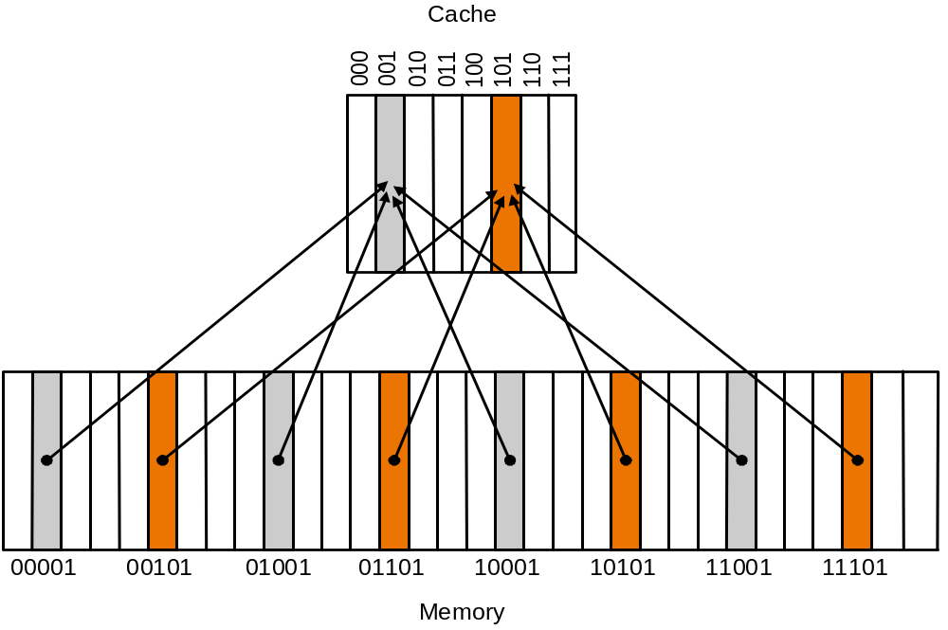









Direct Mapped Cache
Addressing scheme in direct mapped cache:
  cache block address = memory block address mod cache size (unique)
  if cache size = 2^{m}, cache address = lower m bits of n-bit memory address
  remaining upper n-m bits kept kept as tag bits at each cache block
  also need a valid bit to
  recognize valid entry

Slide 8
Accessing Cache
Example:
(0) Initial state:
(1) Address referred 10110 (miss):
Index V Tag Data
000 N
001 N
010 N
011 N
100 N
101 N
110 N
111 N
Index V Tag Data
000 N
001 N
010 N
011 N
100 N
101 N
110 Y 10 Mem(10110)
111 N

Slide 9
(2) Address referred 11010 (miss):
(3) Address referred 10110 (hit):
Index V Tag Data
000 N
001 N
010 Y 11 Mem(11010)
011 N
100 N
101 N
110 Y 10 Mem(10110)
111 N
Index V Tag Data
000 N
001 N
010 Y 11 Mem(11010)
011 N
100 N
101 N
110 Y 10 Mem(10110)
111 N
to CPU
(4) Address referred 10010 (miss):
Index V Tag Data
000 N
001 N
010 Y 10 Mem(10010)
011 N
100 N
101 N
110 Y 10 Mem(10110)
111 N

Slide 10
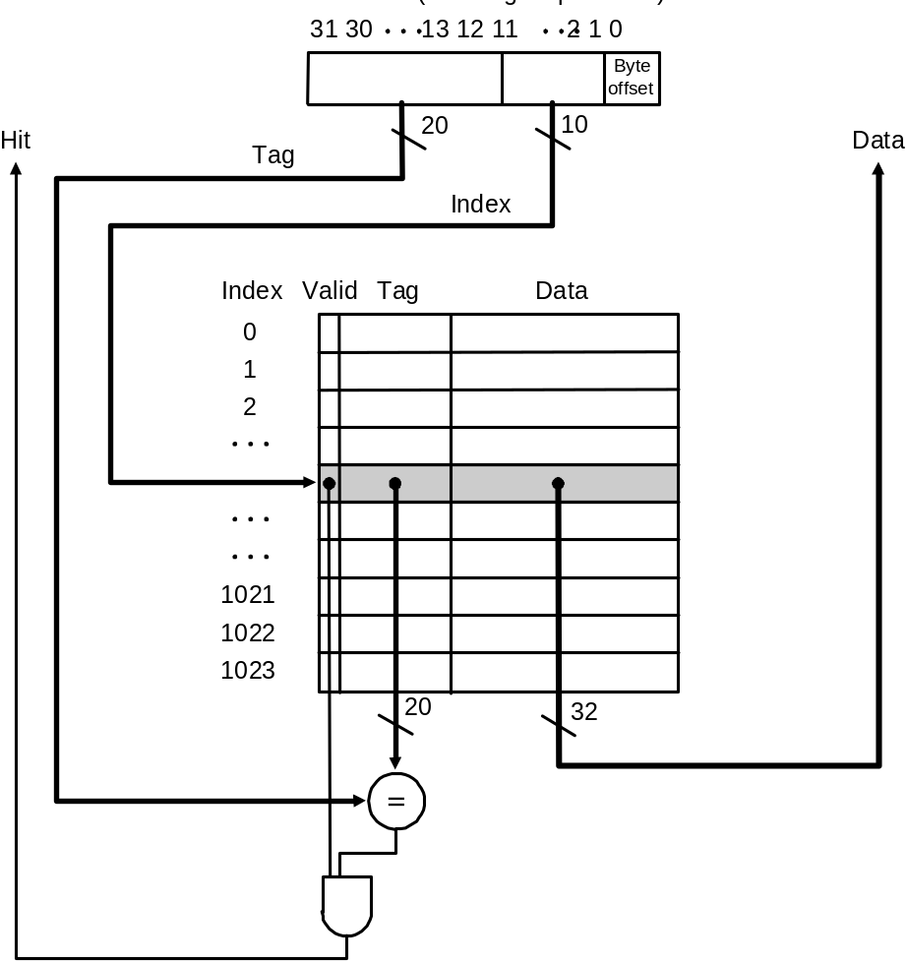
Direct Mapped Cache
Address showing bit positions
MIPS style:
What kind of locality are we taking advantage of?
Cache with 1024 1-word blocks: byte offset
(least 2 significant bits) is ignored and
next 10 bits used to index into cache

Slide 11
Cache Read Hit/Miss
Cache read hit: no action needed
Instruction cache read miss:
  Send original PC value (current PC – 4, as PC has already been incremented in first step of instruction cycle) to memory
  Instruct main memory to perform read and wait for memory to complete access – stall on read
  After read completes write cache entry
  Restart instruction execution at first step to refetch instruction
Data cache read miss:
  Similar to instruction cache miss
  To reduce data miss penalty allow processor to execute instructions while waiting for the read to complete until the word is required – stall on use (why won’t this work for instruction misses?)

Slide 12
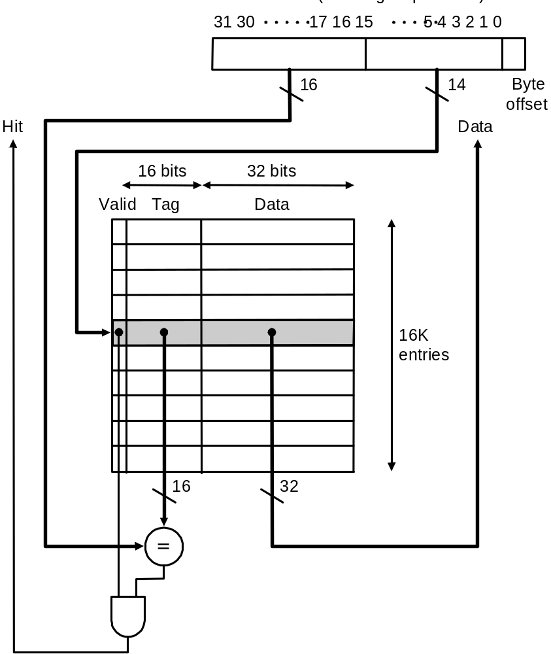
DECStation 3100 Cache
(MIPS R2000 processor)
Address showing bit positions
Cache with 16K 1-word blocks: byte offset
(least 2 significant bits) is ignored and
next 14 bits used to index into cache

Slide 13
Cache Write Hit/Miss
Write-through scheme
  on write hit: replace data in cache and memory with every write hit to avoid inconsistency
  on write miss: write the word into cache and memory – obviously no need to read missed word from memory!
  Write-through is slow because of always required memory write
    performance is improved with a write buffer where words are stored while waiting to be written to memory – processor can continue execution until write buffer is full
    when a word in the write buffer completes writing into main that buffer slot is freed and becomes available for future writes
    DEC 3100 write buffer has 4 words
Write-back scheme
  write the data block only into the cache and write-back the block to main only when it is replaced in cache
  more efficient than write-through, more complex to implement

Slide 14
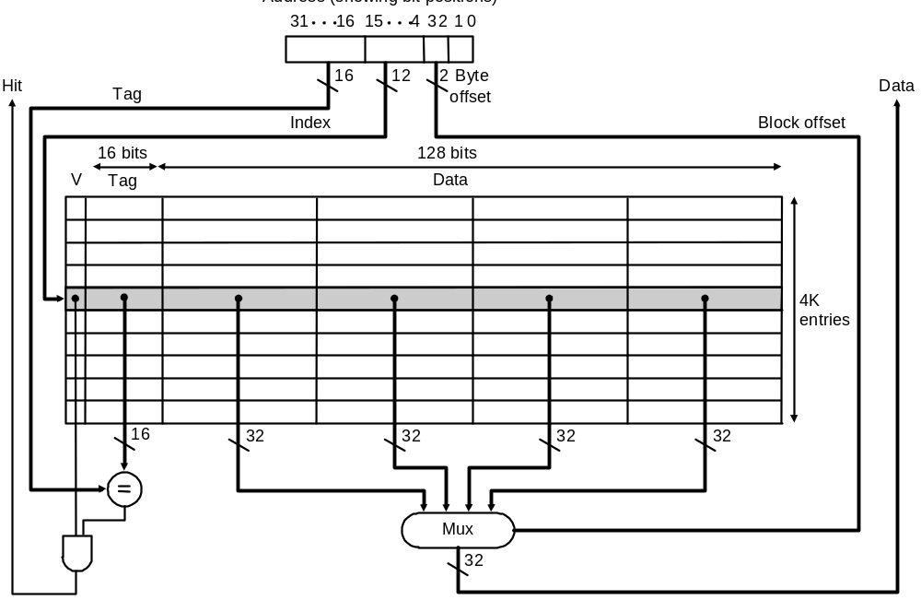
Direct Mapped Cache: Taking Advantage of Spatial Locality
Taking advantage of spatial locality with larger blocks:
Address showing bit positions
Cache with 4K 4-word blocks: byte offset (least 2 significant bits) is ignored, next 2 bits are block offset, and the next 12 bits are used to index into cache

Slide 15
Direct Mapped Cache: Taking Advantage of Spatial Locality
Cache replacement in large (multiword) blocks:
  word read miss: read entire block from main memory
  word write miss: cannot simply write word and tag! Why?!
  writing in a write-through cache:
    if write hit, i.e., tag of requested address and and cache entry are equal, continue as for 1-word blocks by replacing word and writing block to both cache and memory
    if write miss, i.e., tags are unequal, fetch block from memory, replace word that caused miss, and write block to both cache and memory
    therefore, unlike case of 1-word blocks, a write miss with a multiword block causes a memory read

Slide 16
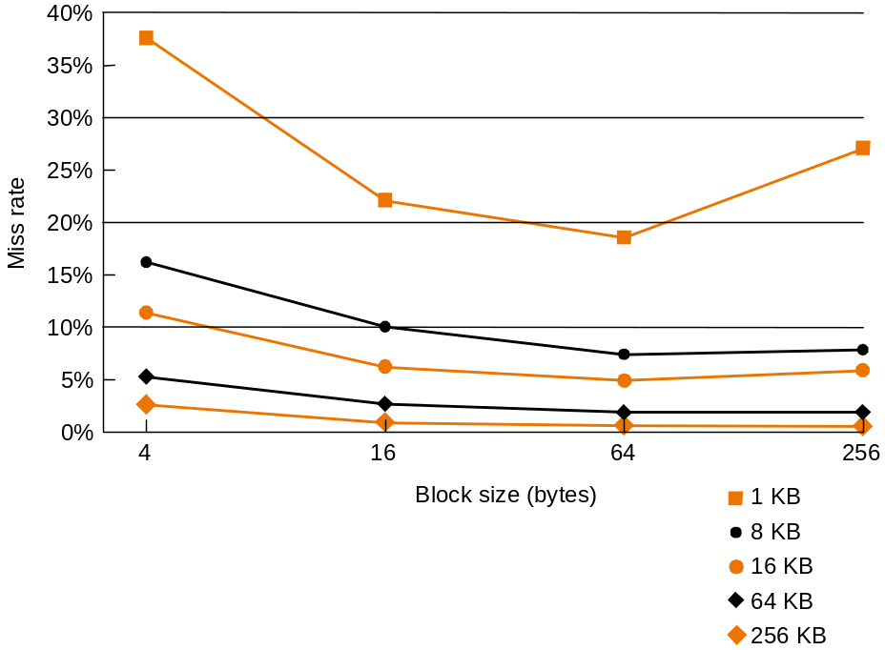
Direct Mapped Cache: Taking Advantage of Spatial Locality
Miss rate falls at first with increasing block size as expected, but, as block size becomes a large fraction of total cache size, miss rate may go up because
  there are few blocks
  competition for blocks increases
  blocks get ejected before most of their words are accessed (thrashing in cache)
Miss rate vs. block size for
various cache sizes

Slide 17
Example Problem
How many total bits are required for a direct-mapped cache with 128 KB of data and 1-word block size, assuming a 32-bit address?
Cache data = 128 KB = 2¹⁷ bytes = 2¹⁵ words = 2¹⁵ blocks
Cache entry size = block data bits + tag bits + valid bit
= 32 + (32 – 15 – 2) + 1 = 48 bits
Therefore, cache size = 2¹⁵ × 48 bits = 2¹⁵ × (1.5 × 32) bits = 1.5 × 2²⁰ bits = 1.5 Mbits
  data bits in cache = 128 KB × 8 = 1 Mbits
  total cache size/actual cache data = 1.5

Slide 18
Example Problem
How many total bits are required for a direct-mapped cache with 128 KB of data and 4-word block size, assuming a 32-bit address?
Cache size = 128 KB = 2¹⁷ bytes = 2¹⁵ words = 2¹³ blocks
Cache entry size = block data bits + tag bits + valid bit
= 128 + (32 – 13 – 2 – 2) + 1 = 144 bits
Therefore, cache size = 2¹³ × 144 bits = 2¹³ × (1.25 × 128) bits = 1.25 × 2²⁰ bits = 1.25 Mbits
  data bits in cache = 128 KB × 8 = 1 Mbits
  total cache size/actual cache data = 1.25

Slide 19
Example Problem
Consider a cache with 64 blocks and a block size of 16 bytes. What block number does byte address 1200 map to?
As block size = 16 bytes:
byte address 1200 ⇒ block address ⎣1200/16 ⎦ = 75
As cache size = 64 blocks:
block address 75 ⇒ cache block (75 mod 64) = 11

Slide 20
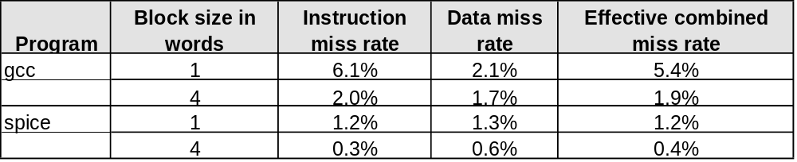
Improving Cache Performance
Use split caches for instruction and data because there is more spatial locality in instruction references:
Make reading multiple words (higher bandwidth) possible by increasing physical or logical width of the system…
Miss rates for gcc and spice in a MIPS R2000
with one and four word block sizes

Slide 21
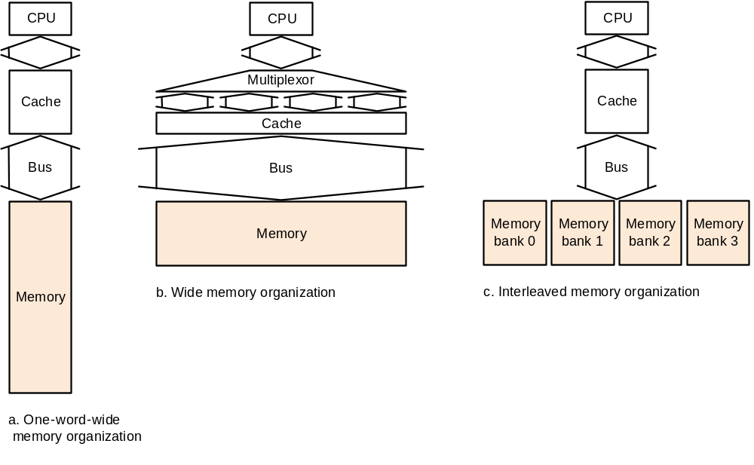
Improving Cache Performance by Increasing Bandwidth
Assume:
  cache block of 4 words
  1 clock cycle to send address to memory address buffer (1 bus trip)
  15 clock cycles for each memory data access
  1 clock cycle to send data to memory data buffer (1 bus trip)
Bus
Proce-
ssor
Memory
bank 0
Memory
bank 1
Memory
bank 2
Memory
bank 3
Interleaved memory units
compete for bus
4 word wide memory and bus
4 word wide memory only
1 + 1*15 +1*1 = 17 cycles
1 +1*15 + 4*1 = 20 cycles
Miss penalties
1 + 4*15 + 4*1 = 65 cycles

Slide 22
Performance
Simplified model assuming equal read and write miss penalties:
  CPU time = (execution cycles + memory stall cycles) × cycle time
  memory stall cycles = memory accesses × miss rate × miss penalty
Therefore, two ways to improve performance in cache:
  decrease miss rate
  decrease miss penalty
  what happens if we increase block size?

Slide 23
Example Problems
Assume for a given machine and program:
  instruction cache miss rate 2%
  data cache miss rate 4%
  miss penalty always 40 cycles
  CPI of 2 without memory stalls
  frequency of load/stores 36% of instructions
How much faster is a machine with a perfect cache that never misses?
What happens if we speed up the machine by reducing its CPI to 1 without changing the clock rate?
What happens if we speed up the machine by doubling its clock rate, but if the absolute time for a miss penalty remains same?

Slide 24
Solution
1.
Assume instruction count = I
Instruction miss cycles = I × 2% × 40 = 0.8 × I
Data miss cycles = I × 36% × 4% × 40 = 0.576 × I
So, total memory-stall cycles = 0.8 × I + 0.576 × I = 1.376 × I
  in other words, 1.376 stall cycles per instruction
Therefore, CPI with memory stalls = 2 + 1.376 = 3.376
Assuming instruction count and clock rate remain same for a perfect cache and a cache that misses:
CPU time with stalls / CPU time with perfect cache
= 3.376 / 2 = 1.688
Performance with a perfect cache is better by a factor of 1.688

Slide 25
Solution (cont.)
2.
CPI without stall = 1
CPI with stall = 1 + 1.376 = 2.376 (clock has not changed so stall cycles per instruction remains same)
CPU time with stalls / CPU time with perfect cache
= CPI with stall / CPI without stall
= 2.376
Performance with a perfect cache is better by a factor of 2.376
Conclusion: with higher CPI cache misses “hurt more” than with lower CPI

Slide 26
Solution (cont.)
3.
With doubled clock rate, miss penalty = 2 × 40 = 80 clock cycles
Stall cycles per instruction = (I × 2% × 80) + (I × 36% × 4% × 80)
= 2.752 × I
So, faster machine with cache miss has CPI = 2 + 2.752 = 4.752
CPU time with stalls / CPU time with perfect cache
= CPI with stall / CPI without stall
= 4.752 / 2 = 2.376
Performance with a perfect cache is better by a factor of 2.376
Conclusion: with higher clock rate cache misses “hurt more” than with lower clock rate

Slide 27
Decreasing Miss Rates with Associative Block Placment
Direct mapped: one unique cache location for each memory block
  cache block address = memory block address mod cache size
Fully associative: each memory block can locate anywhere in cache
  all cache entries are searched (in parallel) to locate block
Set associative: each memory block can place in a unique set of cache locations – if the set is of size n it is n-way set-associative
  cache set address = memory block address mod number of sets in cache
  all cache entries in the corresponding set are searched (in parallel) to locate block
Increasing degree of associativity
  reduces miss rate
  increases hit time because of the parallel search and then fetch

Slide 28
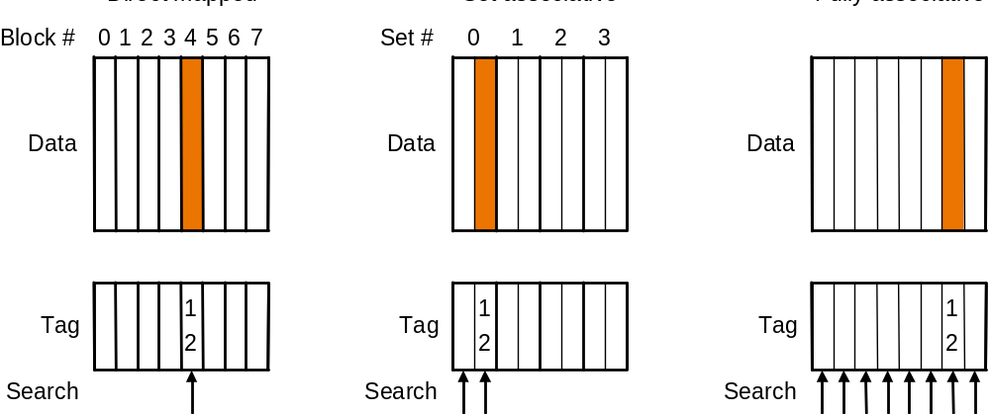
Decreasing Miss Rates with Associative Block Placment
Direct Mapped
2-way Set Associative
Fully Associative
12 mod 8 = 4
12 mod 4 = 0
Location of a memory block with address 12 in a cache with 8 blocks
with different degrees of associativity

Slide 29
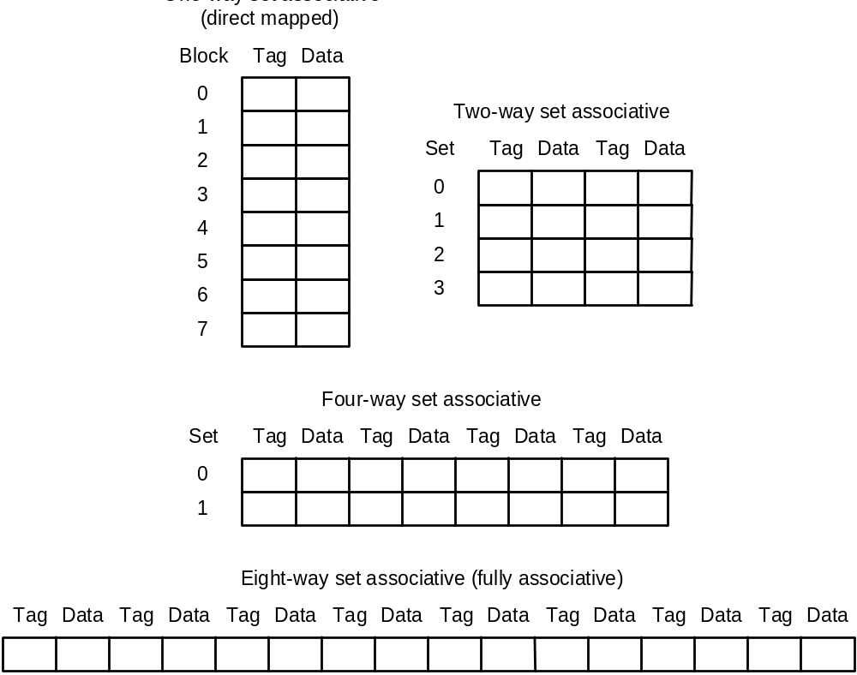
Decreasing Miss Rates with Associative Block Placment
One-way set associative
Configurations of an 8-block cache with different degrees of associativity

Slide 30
Example Problems
Find the number of misses for a cache with four 1-word blocks given the following sequence of memory block accesses: 0, 8, 0, 6, 8, for each of the following cache configurations
  direct mapped
  2-way set associative (use LRU replacement policy)
  fully associative
Note about LRU replacement
  in a 2-way set associative cache LRU replacement can be implemented with one bit at each set whose value indicates the mostly recently referenced block

Slide 31
Solution
1 (direct-mapped)
5 misses
Block address Cache block
0 0 (= 0 mod 4)
6 2 (= 6 mod 4)
8 0 (= 8 mod 4)
Block address translation in direct-mapped cache
Address of memory Hit or Contents of cache blocks after reference
block accessed miss 0 1 2 3
0 miss Memory[0]
8 miss Memory[8]
0 miss Memory[0]
6 miss Memory[0] Memory[6]
8 miss Memory[8] Memory[6]
Cache contents after each reference – red indicates new entry added

Slide 32
Solution (cont.)
2 (two-way set-associative)
Four misses
Block address Cache set
0 0 (= 0 mod 2)
6 0 (= 6 mod 2)
8 0 (= 8 mod 2)
Block address translation in a two-way set-associative cache
Address of memory Hit or Contents of cache blocks after reference
block accessed miss Set 0 Set 0 Set 1 Set 1
0 miss Memory[0]
8 miss Memory[0] Memory[8]
0 hit Memory[0] Memory[8]
6 miss Memory[0] Memory[6]
8 miss Memory[8] Memory[6]
Cache contents after each reference – red indicates new entry added

Slide 33
Solution (cont.)
3 (fully associative)
3 misses
Address of memory Hit or Contents of cache blocks after reference
block accessed miss Block 0 Block 1 Block 2 Block 3
0 miss Memory[0]
8 miss Memory[0] Memory[8]
0 hit Memory[0] Memory[8]
6 miss Memory[0] Memory[8] Memory[6]
8 hit Memory[0] Memory[8] Memory[6]
Cache contents after each reference – red indicates new entry added

Slide 34
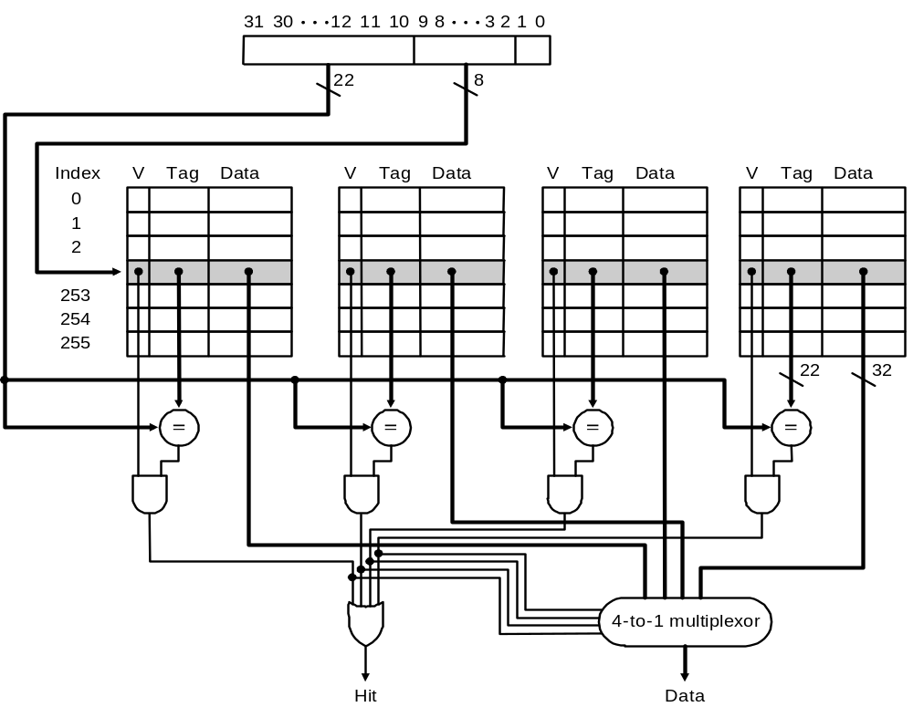
Implementation of a Set-Associative Cache
Address
Set
4-way set-associative cache with 4 comparators and one 4-to-1 multiplexor:
size of cache is 1K blocks = 256 sets * 4-block set size

Slide 35
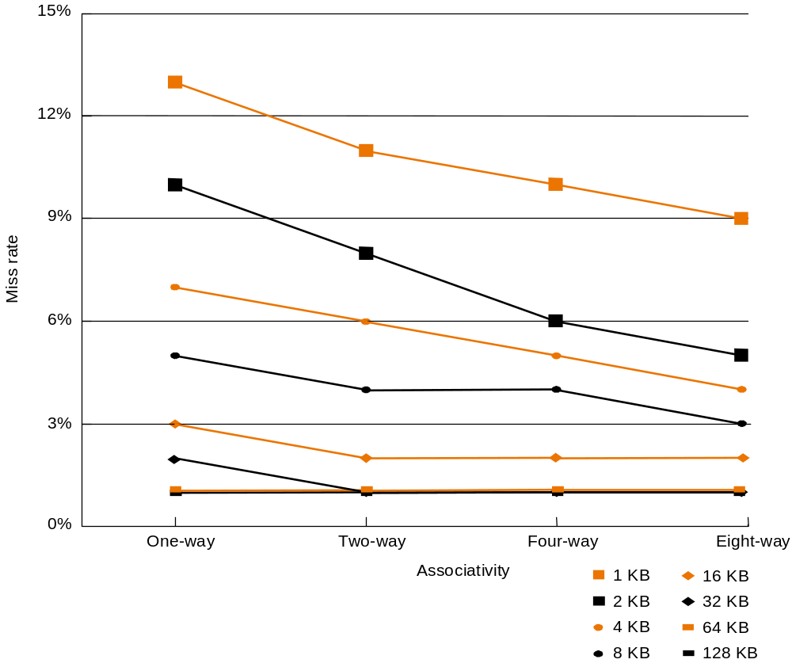
Performance with Set-Associative Caches
Miss rates for each of eight cache sizes
with increasing associativity:
data generated from SPEC92 benchmarks
with 32 byte block size for all caches

Slide 36
Decreasing Miss Penalty with Multilevel Caches
Add a second-level cache
  primary cache is on the same chip as the processor
  use SRAMs to add a second-level cache, sometimes off-chip, between main memory and the first-level cache
  if miss occurs in primary cache second-level cache is accessed
  if data is found in second-level cache miss penalty is access time of second-level cache which is much less than main memory access time
  if miss occurs again at second-level then main memory access is required and large miss penalty is incurred
Design considerations using two levels of caches:
  try and optimize the hit time on the 1st level cache to reduce clock cycle
  try and optimize the miss rate on the 2nd level cache to reduce memory access penalties
  In other words, 2nd level allows 1st level to go for speed without “worrying” about failure…

Slide 37
Example Problem
Assume a 500 MHz machine with
  base CPI 1.0
  main memory access time 200 ns.
  miss rate 5%
How much faster will the machine be if we add a second-level cache with 20ns access time that decreases the miss rate to 2%?

Slide 38
Solution
Miss penalty to main = 200 ns / (2 ns / clock cycle) = 100 clock cycles
Effective CPI with one level of cache
= Base CPI + Memory-stall cycles per instruction
= 1.0 + 5% × 100 = 6.0
With two levels of cache, miss penalty to second-level cache
= 20 ns / (2 ns / clock cycle) = 10 clock cycles
Effective CPI with two levels of cache
= Base CPI + Primary stalls per instruction
+ Secondary stall per instruction
= 1 + 5% × 10 + 2% × 100 = 3.5
Therefore, machine with secondary cache is faster by a factor of
6.0 / 3.5 = 1.71

Slide 39
Virtual Memory
Motivation: main memory acts as cache for secondary storage, e.g., magnetic disk
Virtual address space, i.e., space addressable by a program is determined by ISA
  e.g., 64-bit MIPS address space size is 2⁶⁴ – recall jr instruction
  typically: main memory size ≤ disk size ≤ virtual address space size
Program can “pretend” it has main memory of the size of the disk – which is smaller than thevirtual memory (= whole virtual address space), but bigger than the actual physical memory (=DRAM main memory)
  Page table (as we shall see) transparently converts a virtual memory address to a physical memory address, if the data is already in main; if not, it issues call to OS to fetch the data from disk into main
Virtual memory is organized in fixed-size (power of 2, typically at least 4 KB) blocks, called pages. Physical memory is also considered a collection of pages of the same size.
  the unit of data transfer between disk and physical memory is a page

Slide 40
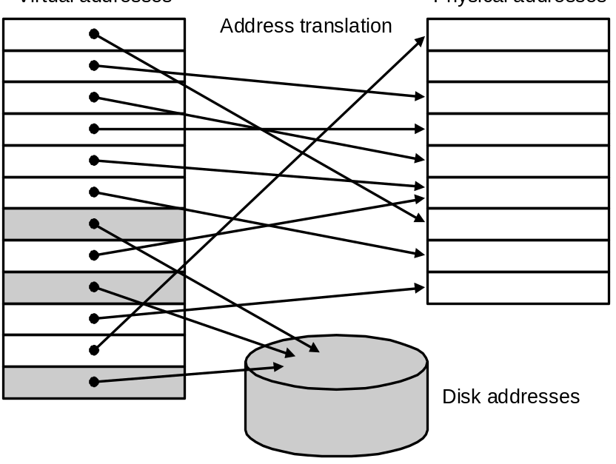
Virtual Memory
Page
Virtual Address
Physical Address
Main Memory
Virtual
Memory
Secondary Storage
Mapping of pages from a virtual address to a
physical address or disk address

Slide 41
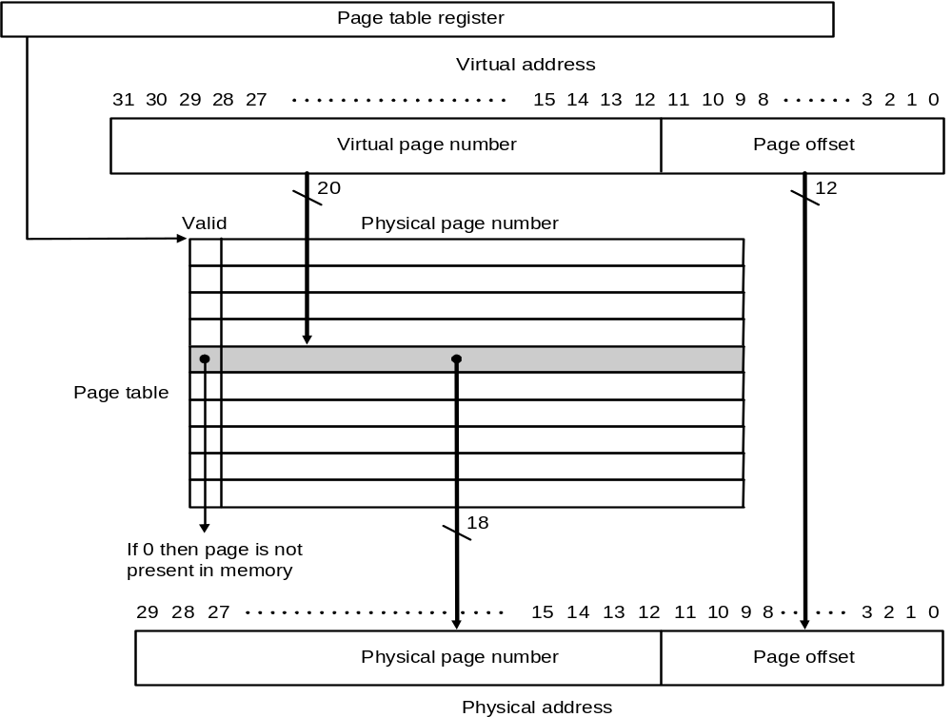
Page Table Implements Virtual to Physical Address Translation
Points to start
of page table
Page table: page size 4 KB, virtual address space 4 GB,
physical memory 1 GB

Slide 42
Example Problem
Assume:
  32-bit virtual address
  4 KB page size
  4 bytes per page table entry
What is the total page table size is we want to be able to access all of the virtual memory?

Slide 43
Solution
No. of page table entries = address space size / page size
= 2³² / 2¹² = 2²⁰
Size of page table = No. of entries × entry size
= 2²⁰ × 4 bytes = 4 MB (huge!)
Note, to avoid large page table size:
  each program has its own page table
    page table register points to start of program’s page table
  to reduce storage required per program page table
    page table for a program covers the span of virtual memory containing its own code and data
    other techniques, e.g., multiple-level page tables, hashing virtual address, etc.

Slide 44
Page Faults
Page fault: page is not in memory, must retrieve it from disk
  enormous miss penalty = millions of cycles
  therefore, page size should be large (e.g., 32 or 64 KB)
    to make one trip to disk worth a lot
  reducing page faults is critical
    LRU replacement policy – implemented approximately by setting a use bit each time a page is accessed, and then periodically clearing all these bits so that pages accessed in a fixed time period are known
    fully associative page placement – consequence of page table
  handle faults in software instead of hardware
    as software overhead is still small compared to disk access time
  using write-through is too expensive, so always use write-back

Slide 45
Resolving Page Faults using the Page Table to Access Disk
There is a data structure, either part of or auxiliary to the page table, which records where each virtual page is stored on disk (cylinder, sector, block, etc.)
V
i
r
t
u
a
l
p
a
g
e
n
u
m
b
e
r
P
a
g
e
t
a
b
l
e
P
h
y
s
i
c
a
l
m
e
m
o
r
y
P
h
y
s
i
c
a
l
p
a
g
e
o
r
V
a
l
i
d
d
i
s
k
a
d
d
r
e
s
s
1
1
1
1
0
1
1
0
1
D
i
s
k
s
t
o
r
a
g
e
1
0
1
Page table maps virtual page to
either physical page or disk page

Slide 46
Making Address Translation Fast with the
Translation-lookaside Buffer
A cache for address translations – translation-lookaside buffer (TLB):
V
i
r
t
u
a
l
p
a
g
e
T
L
B
P
h
y
s
i
c
a
l
p
a
g
e
n
u
m
b
e
r
V
a
l
i
d
T
a
g
a
d
d
r
e
s
s
1
1
P
h
y
s
i
c
a
l
m
e
m
o
r
y
1
1
0
1
P
a
g
e
t
a
b
l
e
V
a
l
i
d
P
h
y
s
i
c
a
l
p
a
g
e
o
r
d
i
s
k
a
d
d
r
e
s
s
1
1
1
D
i
s
k
s
t
o
r
a
g
e
1
0
1
1
0
1
1
0
1
On a page reference, first look up the virtual page number in the TLB; if
there is a TLB miss look up the page table; if miss again then true page fault

Slide 47
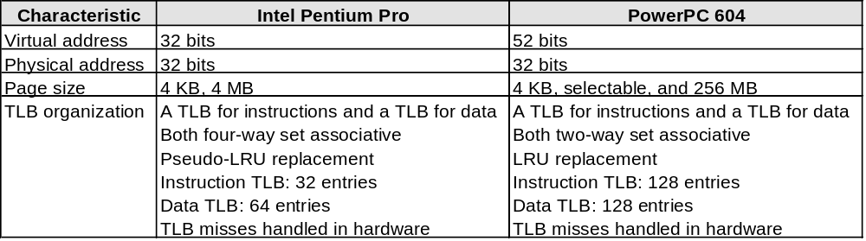
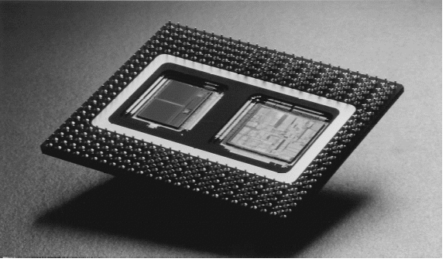
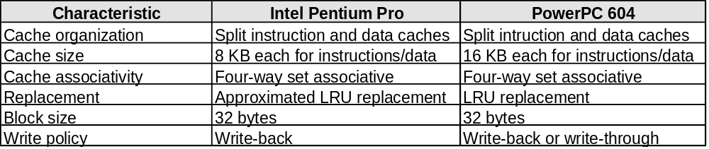
Modern Systems

Slide 48
Some Issues
Processor speeds continue to increase very fast
  much faster than either DRAM or disk access times
Design challenge: dealing with this growing disparity
Trends:
  synchronous SRAMs (provide a burst of data)
  redesign DRAM chips to provide higher bandwidth or processing
  restructure code to increase locality
  use pre-fetching (make cache visible to ISA)

